Slide 1

Identify the medical packages given the medical description containing details of past history , illness, diagnosis, etc.

Slide 2
data exploration
Pandas Profiling: It save us all the work of visualizing and understanding the distribution of each variable. It generates a report with all the information easily available. It tells us
Variables that contain NaN values and variables with many zeros
Correlations and variables with high cardinality
Total characters, unique words, words with frequencies, lowercase, upper case, Punctuation, etc.
Identify languages from text
Generate histogram
Value_counts() with Bar_chart: It shows the count of each category in the Package column. This helps us to identify class imbalance problem associated with the dataset
Dependency Visualization: Here we used scispaCy, a SpaCy model to visualize which pre-trained models will work best for our problem. scispaCy is a Python package containing spaCy models for processing biomedical, scientific or clinical text.
Rough_work: This space was used in parallel to choose the best-performing techniques from Bag-of-Words, TF-IDF, CountVectorizer, and Word-to-Vector along with machine learning algorithms

Slide 3
Data modeling : Approach_1
Step_1: clean_text
For text cleaning, we have used the report generated by Pandas Profiling to get the insight of punctuation, Math Symbols, other symbols, space, etc.
Step_2: lemmatize_text with nltk
Lemmatization considers the context and converts the word to its meaningful base form, whereas stemming just removes the last few characters, often leading to incorrect meanings and spelling errors
‘Caring’ -> Lemmatization -> ‘Care’ ‘Caring’ -> Stemming -> ‘Car’ , Here we are dealing with medical's terminology. So the base meaning is very important
Step_3: TfidfVectorizer (term frequency–inverse document frequency)
Tf-Idf, evaluates how relevant a word is to a document in a collection of documents.
The TfidfVectorizer(CountVectorizer + TfidfTransformer ) will tokenize documents, learn the vocabulary and inverse document frequency weightings, and allow you to encode new documents
TfidfVectorizer give the sparse matrix in the following format: (A,B) C
A: Document index B: Specific word-vector index C: TFIDF score for word B in document A
It indicates the tfidf score for all non-zero values in the word vector for each document.

Slide 4
Data modeling : Approach_1
Step_4: PCA(Principal Component Analysis)
PCA is a solution to the highly redundant features problem. It is suitable in our case because TfidfVectorizer generates 500+ features
The PCA model assumes that the data has a continuous distribution over +/- infinity. NLP data on the other hand, typically has a discrete distribution or a multinomial distribution because the data is based on discrete counts of events or lexical symbols. PCA will do a very poor job of reconstruction discrete data because the values can go negative.
"non-negative matrix factorization" (NMF), "probabilistic latent semantic analysis" (PLSA) and "probabilistic latent Dirichlet analysis" (PLDA).
Step_5: Data Modelling:
Here we simply use the LogisticRegression() to check for the accuracy matrix and to understand the impact of the above steps.
Result: Accuracy = 64%

Slide 5
Data modeling : Approach_2
Step_0: clean_text with SciSpaCy
scispaCy is a powerful tool, especially for named entity recognition (NER), or identifying keywords (called entities) and ordering them into categories
Pre-process the data using scispacy “en_core_sci_md” model to detect medical entities in description
Step_2: lemmatize_text with nltk:
Step_3: TfidfVectorizer (term frequency–inverse document frequency)
Step_4: PCA(Principal Component Analysis)
Step_5: Data Modelling:
Here we have tested several models to identify the best performing model, the impact of the above steps and what can be done next to increase the performance
LogisticRegression() gives the highest accuracy but after visualizing the results from several models we can see that the classes with a lower count decrease the performance, Class imbalance problem
Result: Accuracy = 78%

Slide 6
Data modeling : Approach_3
Step_0: clean_text with SciSpaCy
Step_2: lemmatize_text with nltk:
Step_3: TfidfVectorizer (term frequency–inverse document frequency)
Step_4: PCA(Principal Component Analysis)
Step_4.1: Oversampling with SMOTE (Synthetic Minority Over-sampling Technique )
Since some classes are in minority. So we can use SMOTE to generate more sample form minority class to solve the data imbalance problem
Step_5: Data Modelling:
Here we use the best performing model, LogisticRegression() to check for the accuracy matrix and to understand the impact of the above steps.
Result: Accuracy = 81%

Slide 7
Data modeling : Approach_4
Step_0: clean_text with SciSpaCy
Step_2: lemmatize_text with nltk:
Step_3: TfidfVectorizer (term frequency–inverse document frequency)
Step_4: PCA(Principal Component Analysis)
Step_4.1: Oversampling with SMOTE (Synthetic Minority Over-sampling Technique )
Step_5: Data Modelling:
Here we tune the hyper parameters LogisticRegression() in order to increase the performance
We hit the highest accuracy of 83-84%. The fluctuation in the accuracy is due to SpaCy models and oversampling
Result: Accuracy = 83-84%

Slide 8
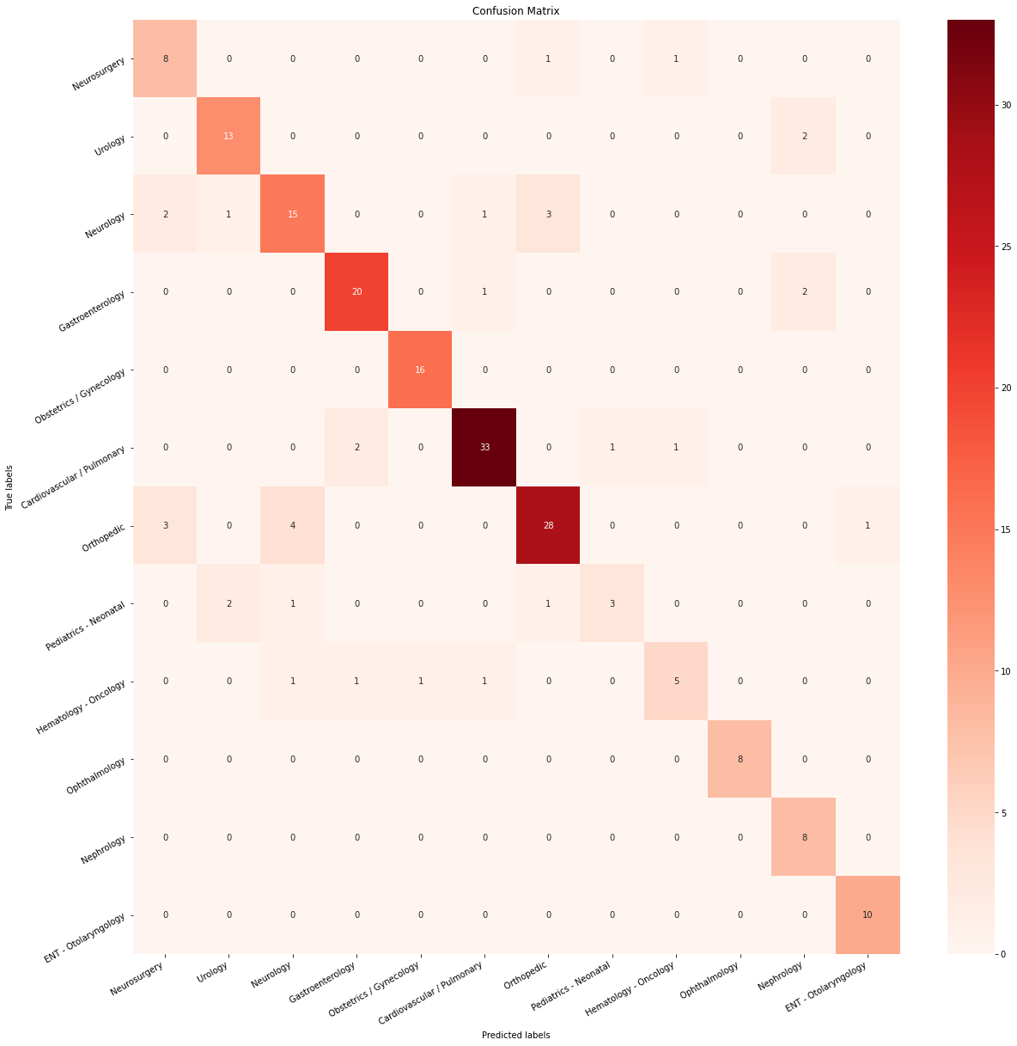
conclusion
The dataset is imbalance and lots of text in description overlaps across categories
Detailed analysis of metrics is used to understand better the specifics of how the algorithm works with different classes
Wider range of algorithms was tried in order to find the best one
For the existing algorithm, tuning has given some more fractions of a percent
We have achieved the highest accuracy of 83-84% with Logistic Regression followed by Multilayer perceptron with 82-81% of accuracy
The overall accuracy can be increased by using BioWordVec & BioSentVec modelstrained on PubMed+MIMIC-III, I'm not able to use these models because of hardware limitation

